Slide 1


Public Sector Innovation trends in OECD countries and beyond
Santiago González, Policy Analyst
Santiago.GONZALEZ@oecd.org
oe.cd/opsi
@OPSIgov
opsi@oecd.org

Slide 2

Public Sector Innovation is Complex and Difficult
Public sector innovation is a fundamentally difficult issue. It has a range of characteristics which mean that it is not an easy thing to command, to manage, or to measure.
DIFFICULT TO DEFINE
THE ROLE OF TIME
01
04
Innovation is hard to define because it is inherently contextual. What is innovative, depends on the context.
What is innovative, and how successful it is, can often only really be judged with the passing of time.
VARIED FORMS AND DEGREES
TOP-DOWN VS BOTTOM-UP
02
05
Public sector innovation comes in many different forms (e.g. service and policy) and degrees (e.g. incremental and radical)
Public sector innovation can be both directed and emergent.
DIFFERENT TO PRIVATE SECTOR
DIFFERENT PURPOSES
03
06
Public sector innovation occurs in a political context, which often makes it much more complex and uncertain than in the private sector.
Public sector innovation can occur for many different reasons. The different reasons require differing forms of innovation and support.
Notes:
Working definition of public sector innovation
The concept of public sector innovation as an explicit pursuit and subject of analysis is relatively recent. There is no universally accepted definition. Building on evidence from the work of OPSI and international research, the following characteristics of public sector innovation emerge:
Novelty: innovations introduce new approaches in a defined context
Implementation: Innovations must be implemented, not just an idea
Impact: Innovations aim at better public results including efficiency, effectiveness and user/ emplyee satisfaction.

Slide 3
WHY DO WE NEED INNOVATION?
Gender equality is still an uphill battle, with little progress against goals
01
Technology is disrupting the status-quo
04
Globalisation is accelerating exponentially, and backlash has increased complexity
35% of jobs to be automated or significantly changed
02
05
Inequality is growing – 8 men control as much wealth as the bottom half of the world
03
06
Trust in governments at all time lows

Slide 4
3 Facets of Innovation to Consider
Delivering on today – mission-oriented public sector innovation. This facet is about ensuring that innovation is occurring in order to meet current burning priorities; that government has the ability to innovate in order to reach its goals. It is likely that this innovation will usually be more incremental in nature, exploiting the knowledge resources of today.
Delivering on tomorrow – anticipatory innovation. This facet is about ensuring that there is exploration and engagement with the emergent issues that will shape future priorities and future commitments. It is likely that this innovation will be more radical in nature, and will be harder to embed in existing structures.
Ensuring innovation readiness – ensuring the necessary absorptive capacity across the Public Service for engaging with new ideas, new methods and new ways of working and delivering. Innovation is not a capability or capacity that can be turned on and off at will, it needs to be nurtured in order to be drawn upon when needed, and to allow for the unexpected to emerge.

Slide 5

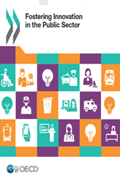
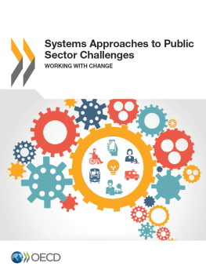
OPSI
The Observatory for Public Sector Innovation (OPSI) team are specialists in public sector innovation. Since 2014, the team has worked with governments to understand and encourage new approaches to address society’s complex problems, providing a collective resource to identify, collect and analyse new ways of designing and delivering policies and services.
UNCOVERING WHAT IS NEXT
Identifying new practices, connecting those engaging in new ways of thinking and acting, and considering what these new approaches mean for the public sector.
1
TURNING THE NEW INTO NORMAL
Studying innovation in different contexts and investigating potential frameworks and methods to encourage innovation in the daily work of public servants.
PROVIDING TRUSTED ADVICE TO FOSTER INNOVATION
Sharing guidance and resources so governments can support innovation to drive better outcomes.
3
2
Notes:
There are three main aspects to OPSI’s work:
Uncovering what’s next
Providing trusted advice
Turning the new into normal
Studying innovation trends is especially important to our mission to serve as a forum for shared lessons and insights into the practice of innovation in government.
In a time of increasing complexity, rapidly changing demands, and considerable fiscal pressures, governments need to understand, test and embed new ways of doing things. One of our key objectives in achieving our mission is uncovering emerging practices and identifying what’s next. This involves identifying new practices at the leading edge of government, connecting those engaging in new ways of thinking and acting, and considering what these new approaches mean for the public sector.
By being armed with information on what other governments are doing, public sector innovators can learn from the successes and lessons learned from others and determine whether such approaches could work in their own context.

Slide 6
MAJOR PUBLIC SECTOR INNOVATION TRENDS
01
Digital identity
04
Citizen focus
02
Systems approaches and enablers
05
Experimentation
03
Inclusiveness and vulnerable populations
06
Data
Notes:
A core component of OPSI’s work is identifying major public sector innovation trends and interpreting their significance to the public sector.
Its recent conference and two-year running innovation trends report has surfaced 6 key trends that are of relevance to leaders and public servants.

Slide 7
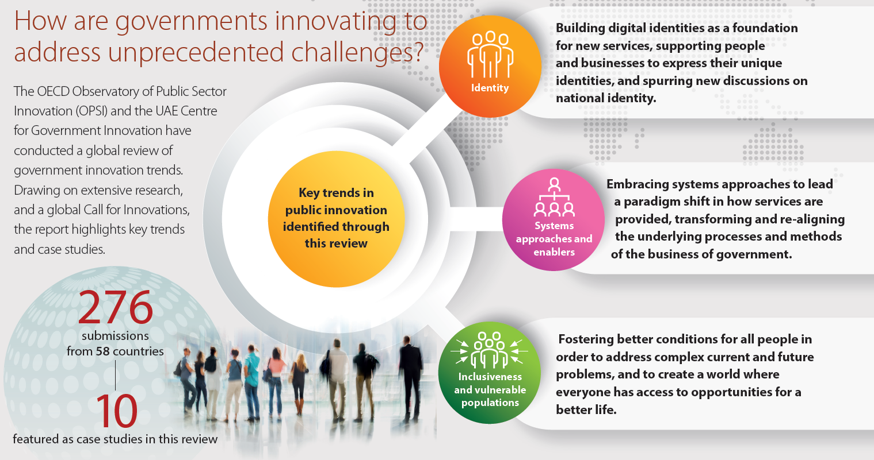
Notes:
For the past two years, OPSI has produced the “Embracing Innovation in Government: Global Trends 2018” Report.
The Report is the result of a global innovation review conducted by OPSI in partnership with UAE’s Mohammed Bin Rashid Centre for Government Innovation (MBRCGI). The review included extensive research and a worldwide crowdsourcing initiative, a global Call for Innovations. The report contains in-depth case studies on 10 of these innovations to illustrate the key trends identified through the review.
In 2018, the OECD Secretary-General Angel Gurría launched OPSI’s report “Embracing Innovation in Government: Global Trends 2018” in Dubai at the World Government Summit, the largest annual gathering in the world focused on shaping the future of governments through innovation.
This research revealed, that governments are:
1. Building digital identity solutions as a foundation for new services, supporting people and businesses to express their unique identities, and spurring new discussions on national identity.
2. Embracing systems approaches and enablers to lead a paradigm shift in how services are provided; transforming and re-aligning the underlying processes and methods of the business of government.
3. Fostering better conditions for inclusiveness and vulnerable populations, in order to address complex current and future problems, and to create a world in which no one is left behind and everyone has access to opportunities for a better life.

Slide 8

Case study:Finland
Cardboard hospital Finland:
What: The cardboard hospital provides an opportunity for staff and architects to meet with patients - as users of the hospital environment and services - and co-create the infrastructure. The central idea is that by constructing physical spaces, one is situated in the environments through all senses, thus enabling new ideas and their evaluation. The need for the method arose from the strategic aim of the hospital to put the patient in the centre of the operations. There was also ongoing planning of a new hospital wing, which was seen as a good piloting opportunity. Various prototyping methods were explored to answer this need.
Results: Architects, managers and developers understand more easily the treatment process, the needs of patients and staff, which enables a quicker designing process. Includes the patients in the design process, which supports the development of customer-centric hospital space and service development practices. Lead to higher user satisfaction.
Notes:
Full case study: https://www.oecd.org/governance/observatory-public-sector-innovation/innovations/page/citizenshops.htm#tab_results

Slide 9

Case study: Sweden
Pension rights and information: Min Pension in Sweden
What: Min Pension is a service which on a daily basis helps Swedish people to get an overall picture of their earned pension rights, and helps them make a projection on their old age pension. The website can be accessed by one click from external internet sites, such as the Swedish Pensions Agency, several banks and pension companies.
Results: People are provided with comprehensive information on their pension rights and the Swedish pension system. More than 2.1 million registered users and more than 12 million pension agreements collected in the database guarantee transparency. A well organised platform for the public and the private sector in the pension area.
Notes:
Full case study: https://www.oecd.org/governance/observatory-public-sector-innovation/innovations/page/followyourpension.htm#tab_results

Slide 10

Case study: South Africa
Social insurance institutional arrangements: NSSF in South Africa
What: Agency approach for the delivery of social insurance schemes to redress incoherence and fragmentation of the different administrations administering social insurance schemes in the country. An institutional design for the implementation of the mandatory National Social Security Fund (NSSF) in the delivery of death, disability and retirement benefits was created.
Results: The Agency Approach consolidates the different administrations into a single hub of delivery, preventing double or triple dipping, and savings administrative costs. This improved efficiency and effectiveness in social insurance delivery and improved capability to identify trends in resource allocation.
Notes:
Full case study: https://www.oecd.org/governance/observatory-public-sector-innovation/innovations/page/agencyapproachtodeliveryofsocialinsuranceschemes.htm#tab_description

Slide 11
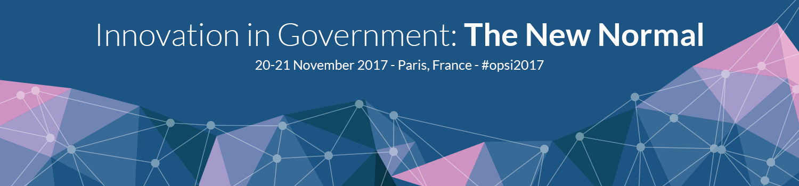


Notes:
In November 2017, OPSI convened a two day conference was organised in cooperation with the European Commission’s Directorate-General for Research and Innovation and featured a series of plenaries, discussions and participant-led workshops organised around four main pillars of conversation:
Transforming government: How to rebuild the systems, cultures and technology to empower government to tackle 21st century challenges?
Methods and tools: What frameworks, skills, and methods are useful to unlocking creativity and innovation? What needs to happen to embed them in the day-to-day work of public servants?
Re-imagining boundaries: In the future, what is the role of government?
Innovation for development: How can innovation support sustainable development?
Three main trends were surfaced in conference discussions.
Explore experimentation
Experimentation was discussed in two senses at the conference. The first way was in terms of method and methodology. Evidence produced through formal experiments is increasingly finding favour within governments. Experimentation was talked of positively, as it allows for iteration: rather than trying to tackle a complimented problem in one, all-encompassing expensive attempt, a small run of experiments can give government the kind of feedback it needs to ever refine its solution to meets its objectives. Experimentation was also discussed more colloquially, in terms of the need for public servants to be more exploratory in their work, to try new things and, even, to potentially fail. An oft repeated refrain was the need for ‘permission’ to do this and, so, the importance of culture and environment was also foregrounded
Inform decisions with data
Good decisions need good evidence. Under the rubric of evidence-based policymaking, the conference explored questions about how data should best be collected, organised, used and (most importantly) for what purpose. In asking how governments could and should harness data to fuel innovation and transform operations, we also turned our attention to the skills and capabilities with which public servants need to be endowed, in order to do so.
Put the citizen at the centre
Innovation in government is about finding new ways to impact the lives of citizens, and new approaches to activating them as partners to shape the future together. A strong message was repeated throughout the conference: involve citizens early and often. Doing so promotes government transparency and responsiveness to contextual needs and allows it to collaborate and forge partnerships with those who have the most stake in a policy or programme’s outcome.

Slide 12
Join our newsletter at http://tiny.cc/opsinewsletter
oe.cd/opsi
@OPSIgov
opsi@oecd.org

